Slide 1
Convex Hulls
algorithms and data structures
Convexivity
Package-Wrap Algorithm
Graham Scan
Dynamic Convex Hull
Convex Hull

Slide 2
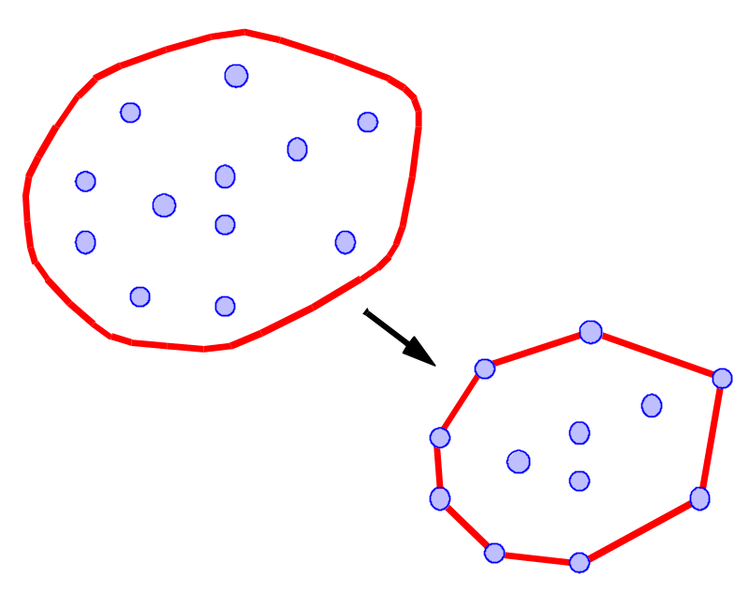
What is a Convex Hull?
Let S be a set of points in the plane.
Intuition: Imagine the points of S as being pegs; the convex hull of S is the shape of a rubber-band stretched around the pegs.
Formal definition: the convex hull of S is the smallest convex polygon that contains all the points of S.
Convex Hull

Slide 3
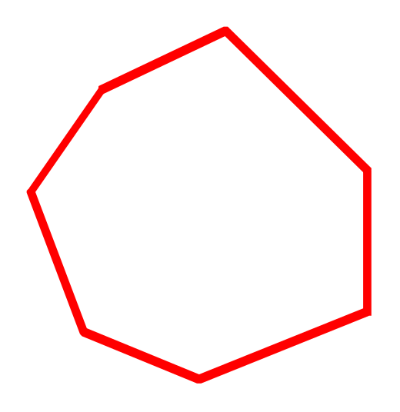
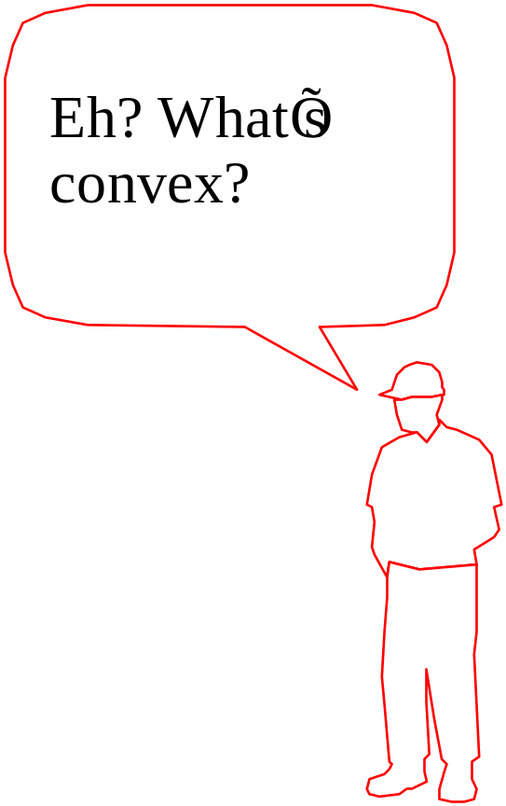
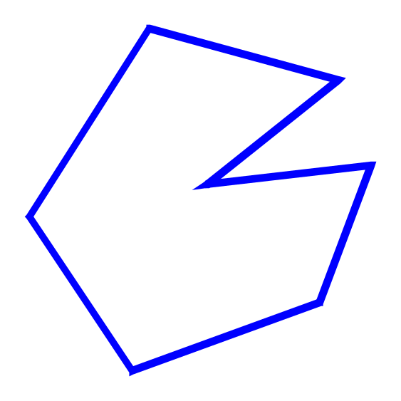
Convexity
convex
A polygon P is said to be convex if:
  P is non-intersecting; and
  for any two points p and q on the boundary of P, segment pq lies entirely inside P
Non convex
Convex Hull

Slide 4
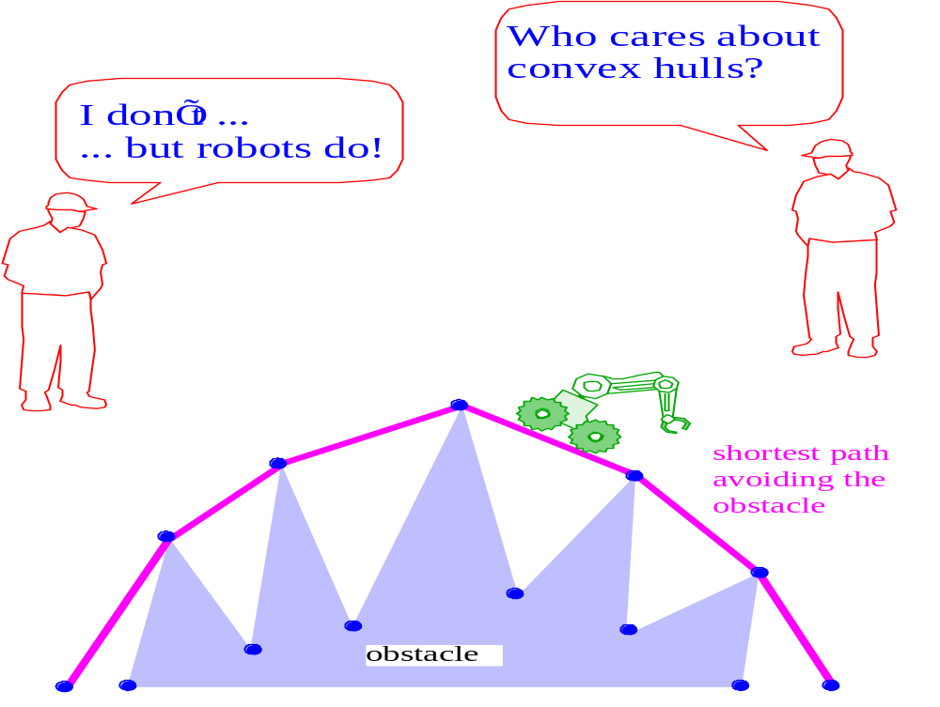
Why Convex Hulls?
Convex Hull

Slide 5
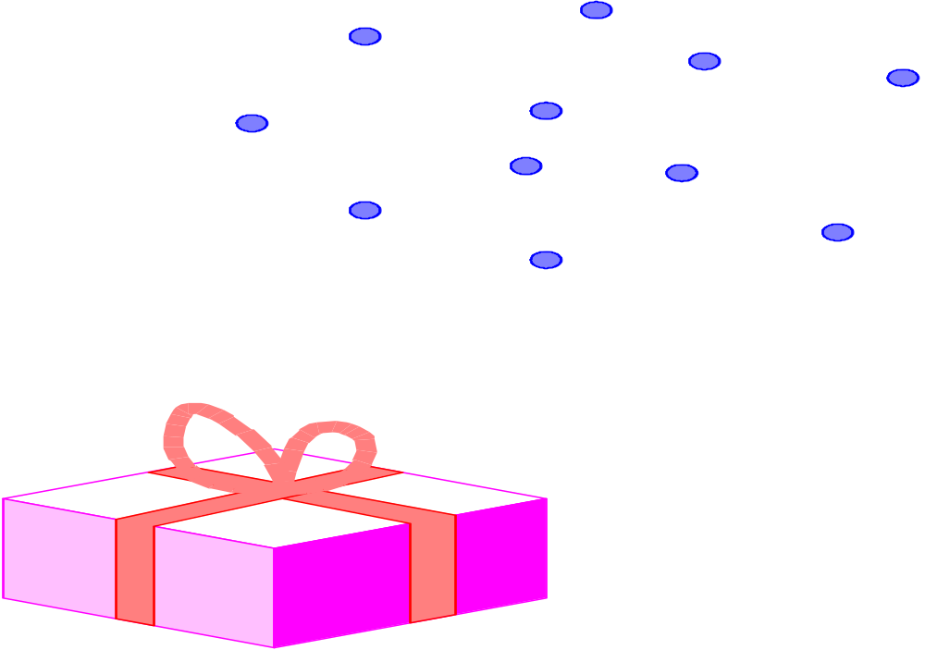
The Package Wrapping Algorithm
Idea: Think of wrapping a package. Put the paper in contact with the package and continue to wrap around from one surface to the next until you get all the way around.
Convex Hull

Slide 6
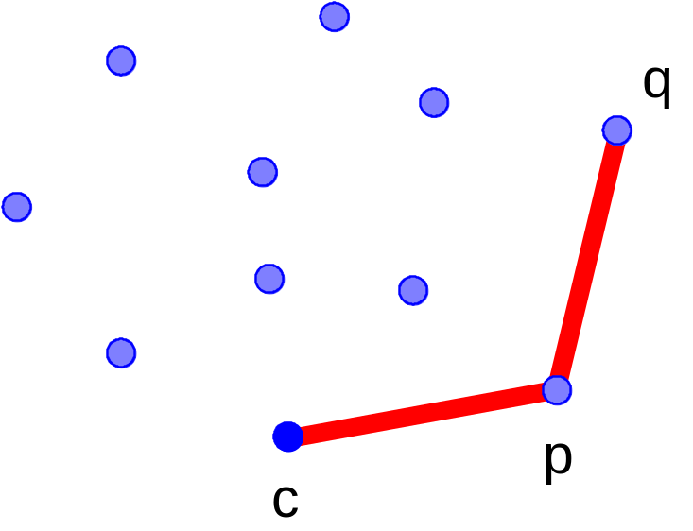
Package Wrap
Question: Given the current point, how do we compute the next point to be wrapped?
  Set up an orientation tournament using the current point as the anchor-point.
  The next point is selected as the point that beats all other points at Counter Clockwise(CCW) orientation, i.e., for any other point, we have orientation(c, p, q) = CCW
Convex Hull

Slide 7
Time Complexity of Package Wrap
For every point on the hull we examine all the other points to determine the next point
Notation:
  N: number of points
  M: number of hull points (M ≤ N)
Time complexity: Θ(M N)
Worst case: Θ(N²)
  (All the points are on the hull, and thus M = N)
Average case: Θ(N log N ) — Θ(N^{4/3})
  for points randomly distributed inside a square, M = Θ(log N) on average
  for points randomly distributed inside a circle, M = Θ(N^{1/3}) on average
Convex Hull

Slide 8
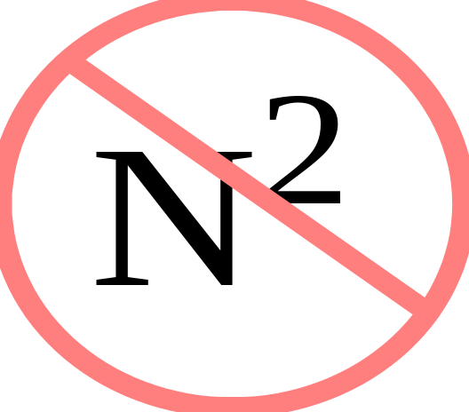
Package Wrap has worst-case time complexity O( N² )
Which is bad...
But in 1972, Nabisco needed a better cookie - so they hired R. L. Graham, who came up with...
Convex Hull

Slide 9

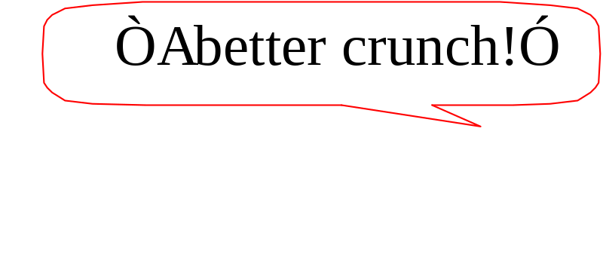
The Graham Scan Algorithm
Rave Reviews:
  “Almost linear!” Sedgewick
  “It’s just a sort!” Atul
  “Two thumbs up!” Siskel and Ebert
Nabisco says...
and history was made.
Convex Hull

Slide 10
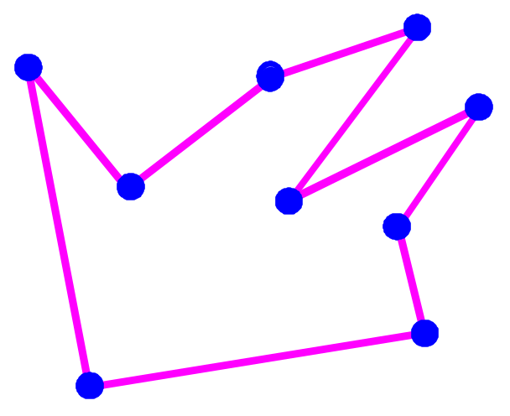
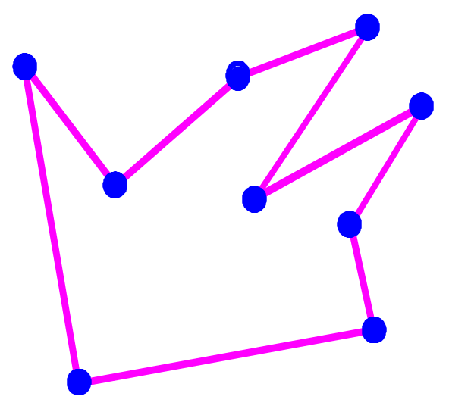
Graham Scan
Form a simple polygon (connect the dots as before)
Remove points at concave angles (one at a time, backtracking one step when any point is removed).
Continue until you get all the way around.
Convex Hull

Slide 11
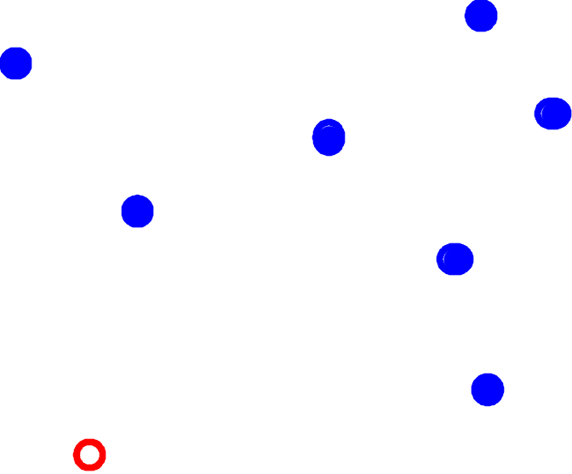
Graham Scan How Does it Work?
Start with the lowest point (anchor point)
Convex Hull

Slide 12
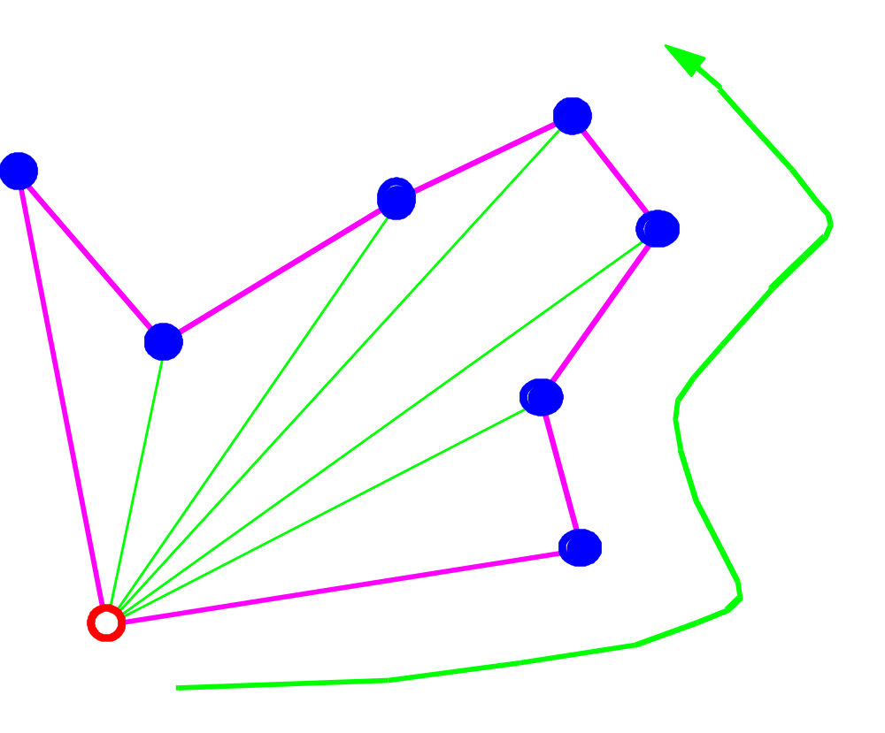
Graham Scan: Phase 1
Now, form a closed simple path traversing the points by increasing angle with respect to the anchor point
Convex Hull

Slide 13
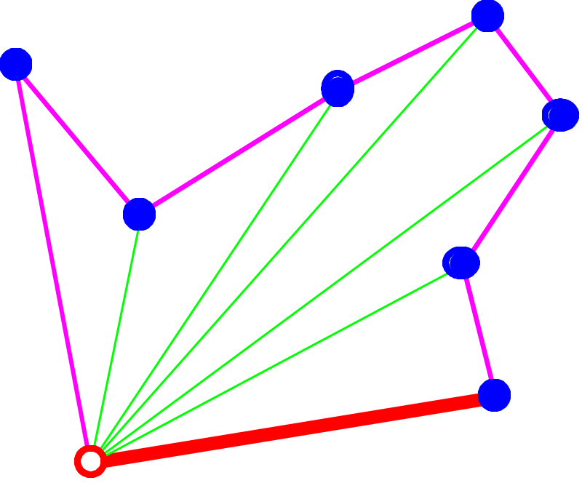
Graham Scan: Phase 2
The anchor point and the next point on the path must be on the hull (why?)
Convex Hull

Slide 14
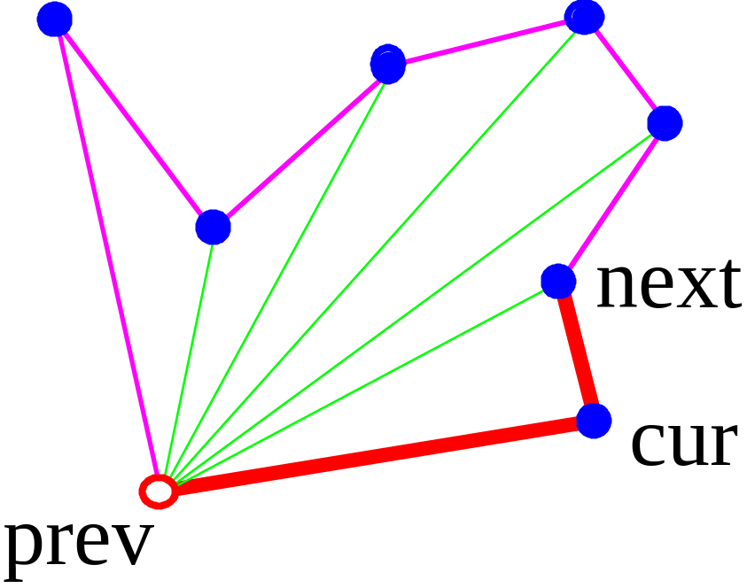
Graham Scan: Phase 2
keep the path and the hull points in two sequences
  elements are removed from the beginning of the path sequence and are inserted and deleted from the end of the hull sequence
orientation is used to decide whether to accept or reject the next point
Convex Hull

Slide 15
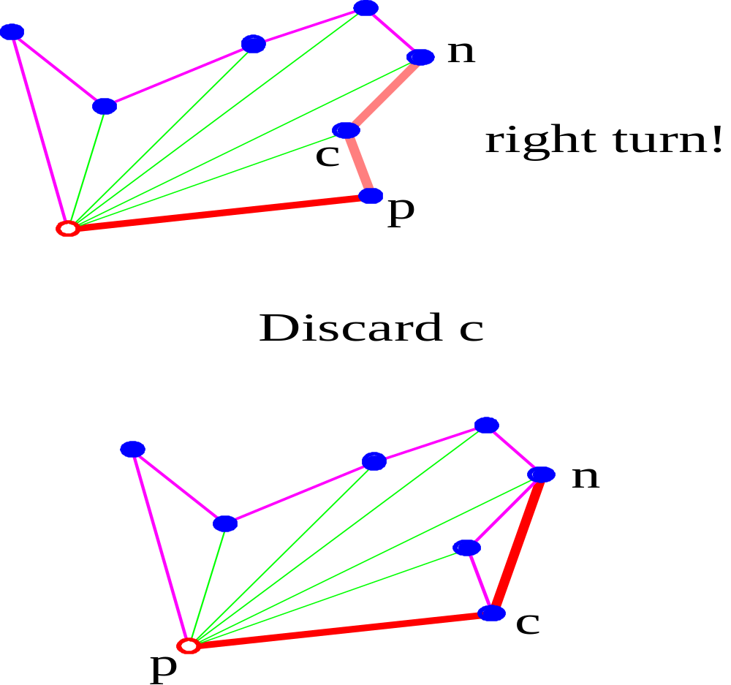
(p,c,n) is a
Convex Hull

Slide 16
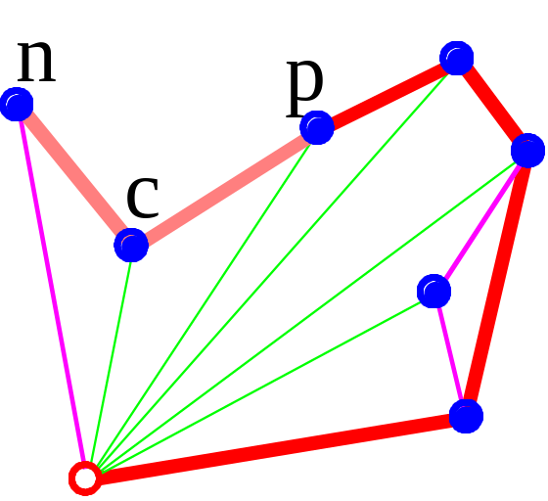
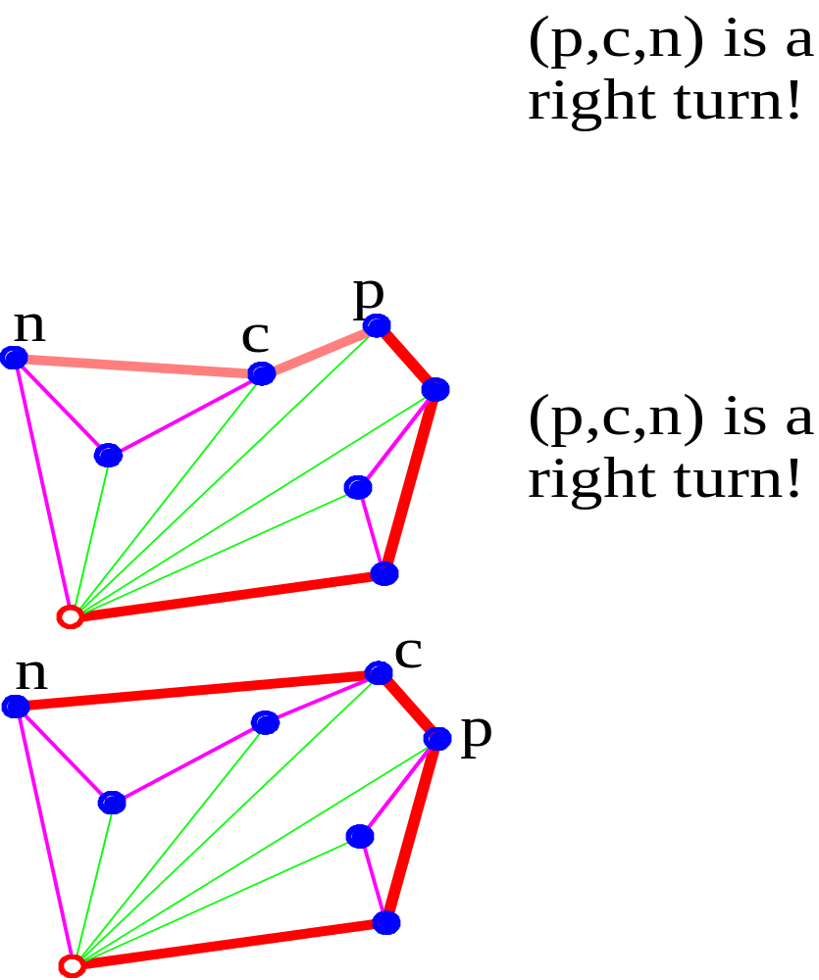
Convex Hull

Slide 17
Time Complexity of Graham Scan
Phase 1 takes time O(N logN)
  points are sorted by angle around the anchor
Phase 2 takes time O(N)
  each point is inserted into the sequencen exactly once, and each point is removed from the sequence at most once
Total time complexity O(N log N)
Convex Hull

Slide 18
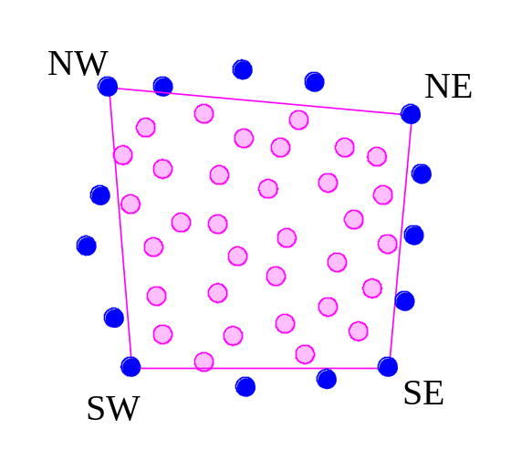
How to Increase Speed
Wipe out a lot of the points you know won’t be on the hull! This is called interior elimination. One approach:
  Find the farthest points in the SW, NW, NE, and SE directions
  Eliminate the points inside the quadrilateral (SW, NW, NE, SE)
  only O(√N) points are left on average, if points are uniformly distributed on a unit square!
Do Package Wrap or Graham Scan on the remaining points
Convex Hull

Slide 19
Dynamic Convex Hull
The basic convex hull algorithms were fairly interesting, but you may have noticed that you can’t draw the hull until after all of the points have been specified.
Is there an interactive way to add points to the hull and redraw it while maintaining an optimal time complexity?
Convex Hull

Slide 20
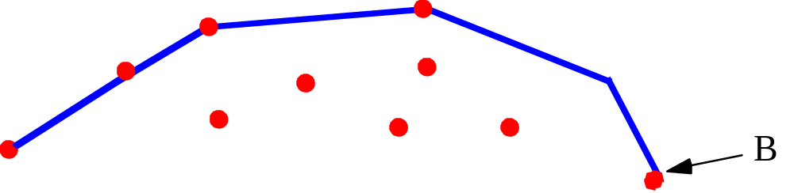
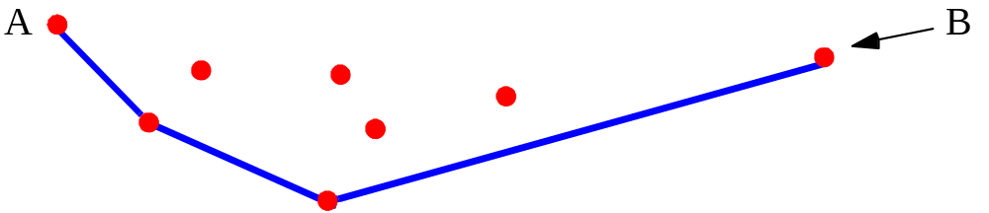
Two Halves = One Hull
For this algorithm, we consider a convex hull as being two parts:
An upper hull...
and a lower hull...
Convex Hull

Slide 21
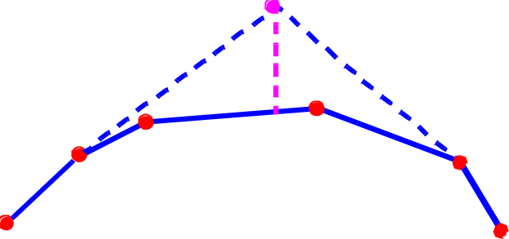
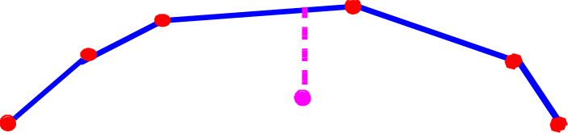
Adding points: Case 1
Case 1: the new point is within the horizontal span of the hull
Upper Hull 1a:
If the new point is above the upper hull, then it should be added to the upper hull and some upper-hull points may be removed.
.
Upper Hull 1b:
If the new point is below the upper hull, no changes need to be made
Convex Hull

Slide 22
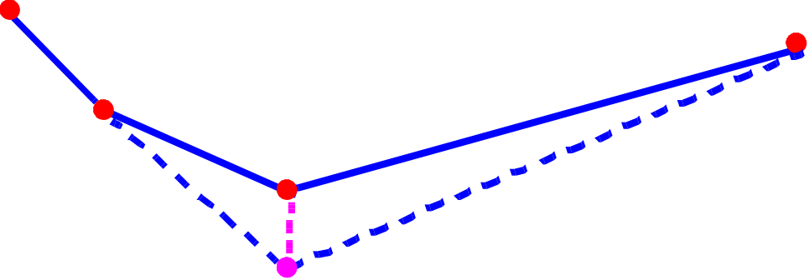
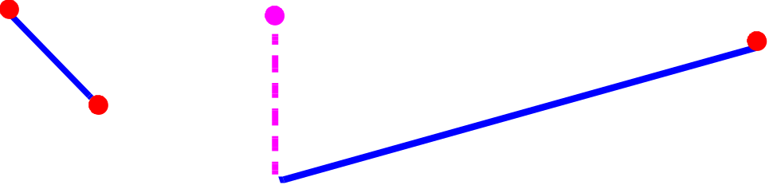
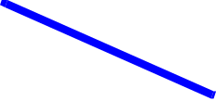
Case 1 (cont.)
The cases for the lower hull are similar.
Lower Hull 1a:
If the new point is below the lower hull, then it is added to the lower
hull and some lower-hull points may be removed.
Lower Hull 1b:
If the added point is above the existing point, it is inside the existing
lower hull, and no changes need be made.
Convex Hull

Slide 23
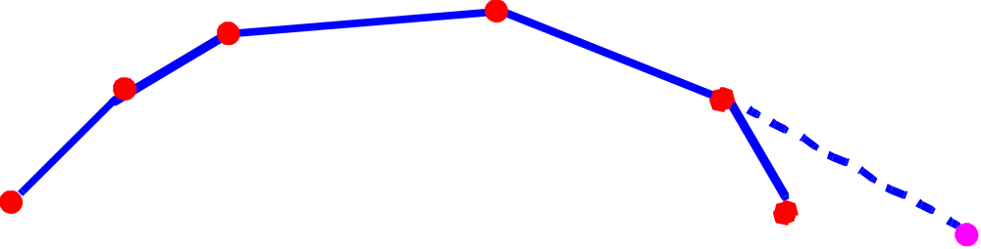
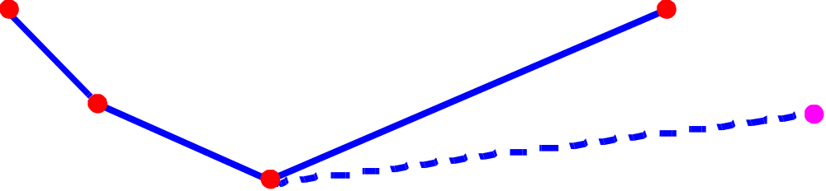
Adding Points: Case 2
Case 2: the new point is outside the horizontal span of the hull
We must modify both the upper and lower hulls accordingly.
Convex Hull

Slide 24
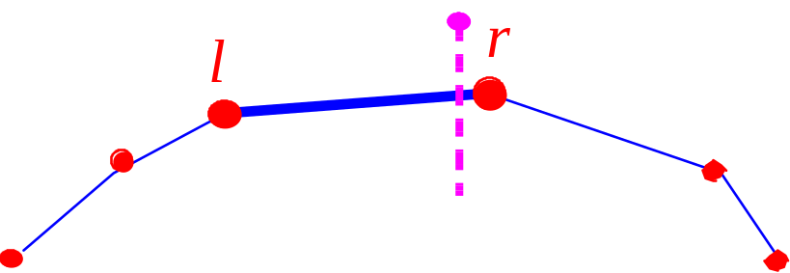
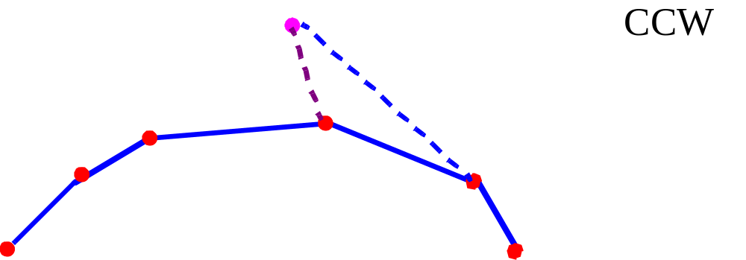
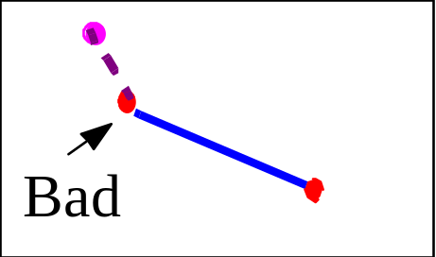
Hull Modification
In Case 1, we determine the vertices l and r of the upper or lower hulls immediately preceding/following the new point p in the x-order.
If p has been added to the upper hull, examine the upper hull rightward starting at r. If p makes a CCW turn with r and its right neighbor, remove r. Continue until there are no more CCW turns. Repeat for point l examining the upper hull leftward. The computation for the bottom hull is similar
Convex Hull

